Slide 1

Background in geospatial data modeling
Extended Semantic Web Conference 2012
Presenter: Manolis Koubarakis

Slide 2
Outline
Basic GIS concepts and terminology
Abstract geographic space modeling paradigms
Concrete representations for the abstract modeling paradigms
Geospatial data standards
2
Notes:
Suvayu Ali, S.F.U.
2
5/17/11
Suvayu Ali, S.F.U.
2

Slide 3
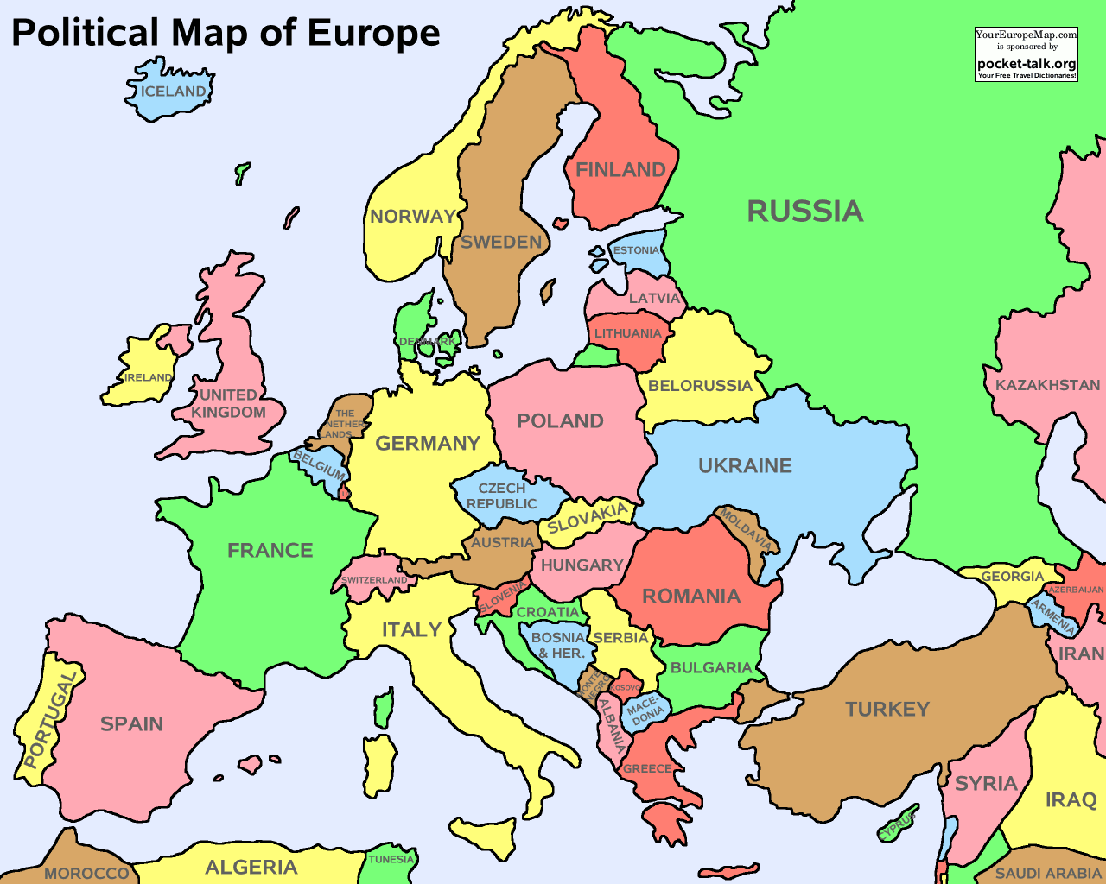
Basic GIS Concepts and Terminology
Theme: the information corresponding to a particular domain that we want to model. A theme is a set of geographic features.
Example: the countries of Europe
3
Notes:
Suvayu Ali, S.F.U.
3
5/17/11
Suvayu Ali, S.F.U.
3

Slide 4
Basic GIS Concepts (cont’d)
Geographic feature or geographic object: a domain entity that can have various attributes that describe spatial and non-spatial characteristics.
Example: the country Greece with attributes
        Population
        Flag
        Capital
        Geographical area
        Coastline
        Bordering countries
4
Notes:
Suvayu Ali, S.F.U.
4
5/17/11
Suvayu Ali, S.F.U.
4

Slide 5
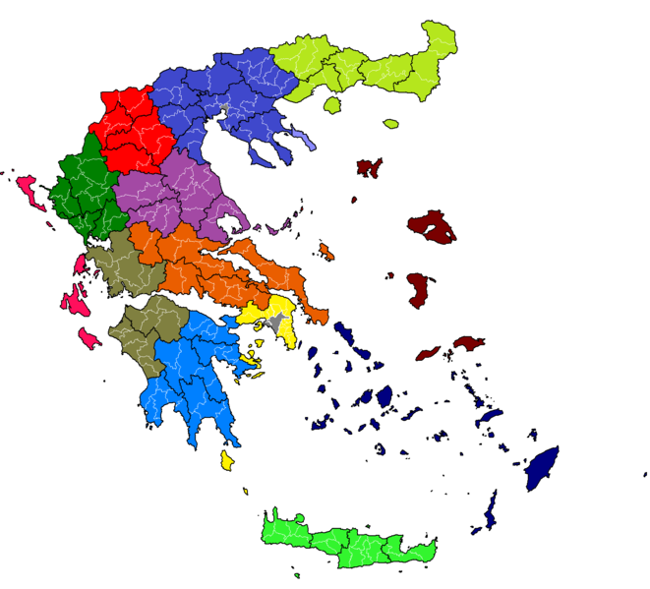
Basic GIS Concepts (cont’d)
Geographic features can be atomic or complex.
Example: According to the Kallikratis administrative reform of 2010, Greece consists of:
    13 regions (e.g., Crete)
    Each region consists of perfectures (e.g., Heraklion)
    Each perfecture consists of municipalities (e.g., Dimos Chersonisou)
5
Notes:
Suvayu Ali, S.F.U.
5
5/17/11
Suvayu Ali, S.F.U.
5

Slide 6
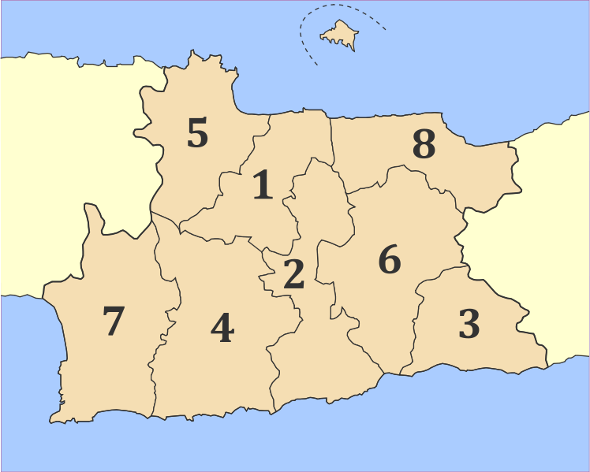
Basic GIS Concepts (cont’d)
The spatial characteristics of a feature can involve:
  Geometric information (location in the underlying geographic space, shape etc.)
  Topological information (containment, adjacency etc.).
Municipalities of the perfecture of Heraklion:
1. Dimos Irakliou
2. Dimos Archanon-Asterousion
3. Dimos Viannou
4. Dimos Gortynas
5. Dimos Maleviziou
6. Dimos Minoa Pediadas
7. Dimos Festou
8. Dimos Chersonisou
6
Notes:
Suvayu Ali, S.F.U.
6
5/17/11
Suvayu Ali, S.F.U.
6

Slide 7
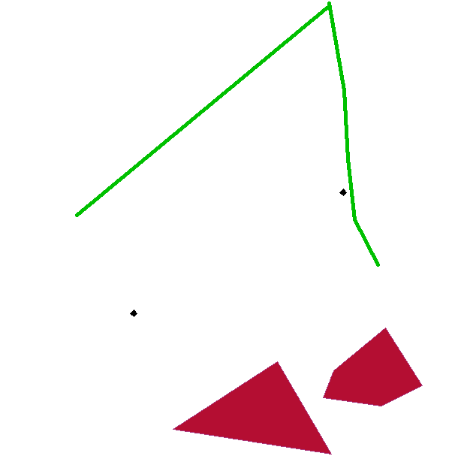
Geometric Information
Geometric information can be captured by using geometric primitives (points, lines, polygons, etc.) to approximate the spatial attributes of the real world feature that we want to model.
Geometries are associated with a coordinate reference system (or spatial reference system) which describes the coordinate space in which the geometry is defined.
7
Notes:
Suvayu Ali, S.F.U.
7
5/17/11
Suvayu Ali, S.F.U.
7

Slide 8
Topological Information
Topological information is inherently qualitative and it is expressed in terms of topological relations (e.g., containment, adjacency, overlap etc.).
Topological information can be derived from geometric information or it might be captured by asserting explicitly the topological relations between features.
8
Notes:
Suvayu Ali, S.F.U.
8
5/17/11
Suvayu Ali, S.F.U.
8

Slide 9
Topological Relations
The study of topological relations has produced a lot of interesting results by researchers in:
  GIS
  Spatial databases
  Artificial Intelligence (qualitative reasoning and knowledge representation)
9
Notes:
Suvayu Ali, S.F.U.
9
5/17/11
Suvayu Ali, S.F.U.
9

Slide 10

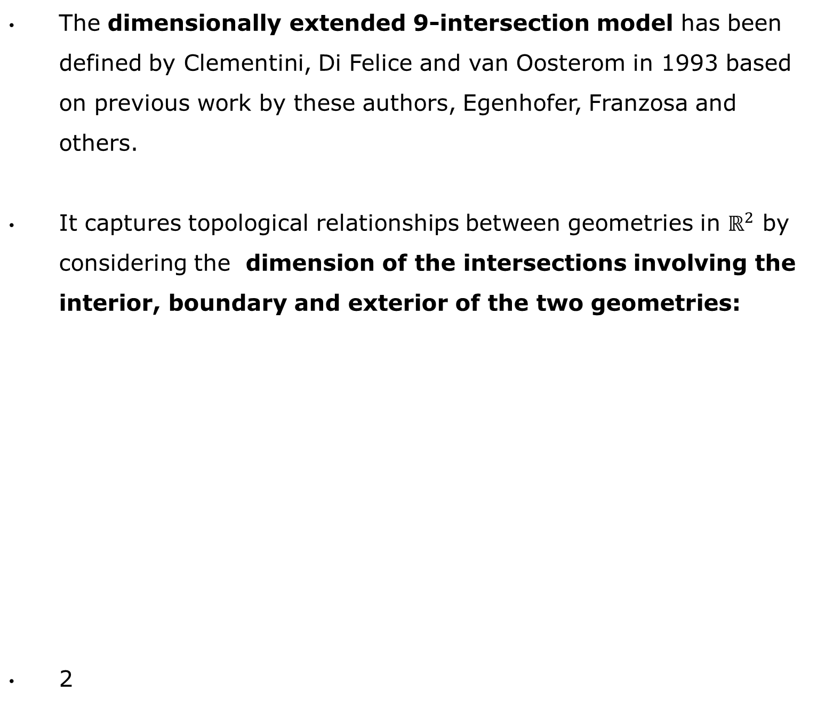
DE-9IM
The dimensionally extended 9-intersection model has been defined by Clementini, Di Felice and van Oosterom in 1993 based on previous work by these authors, Egenhofer, Franzosa and others.
It captures topological relationships between geometries in $ℝ^{2}$ by considering the dimension of the intersections involving the interior, boundary and exterior of the two geometries:
2
10
Notes:
Suvayu Ali, S.F.U.
10
5/17/11
Suvayu Ali, S.F.U.
10

Slide 11
Example: A DISJOINT C
A
 | I(C) | B(C) | E(C)
I(A) | F | F | *
B(A) | F | F | *
E(A) | * | * | *
C
11
Notes:
Suvayu Ali, S.F.U.
11
5/17/11
Suvayu Ali, S.F.U.
11

Slide 12
Example: A WITHIN C
C
 | I(C) | B(C) | E(C)
I(A) | T | * | F
B(A) | * | * | F
E(A) | * | * | *
A
12
Notes:
Suvayu Ali, S.F.U.
12
5/17/11
Suvayu Ali, S.F.U.
12

Slide 13
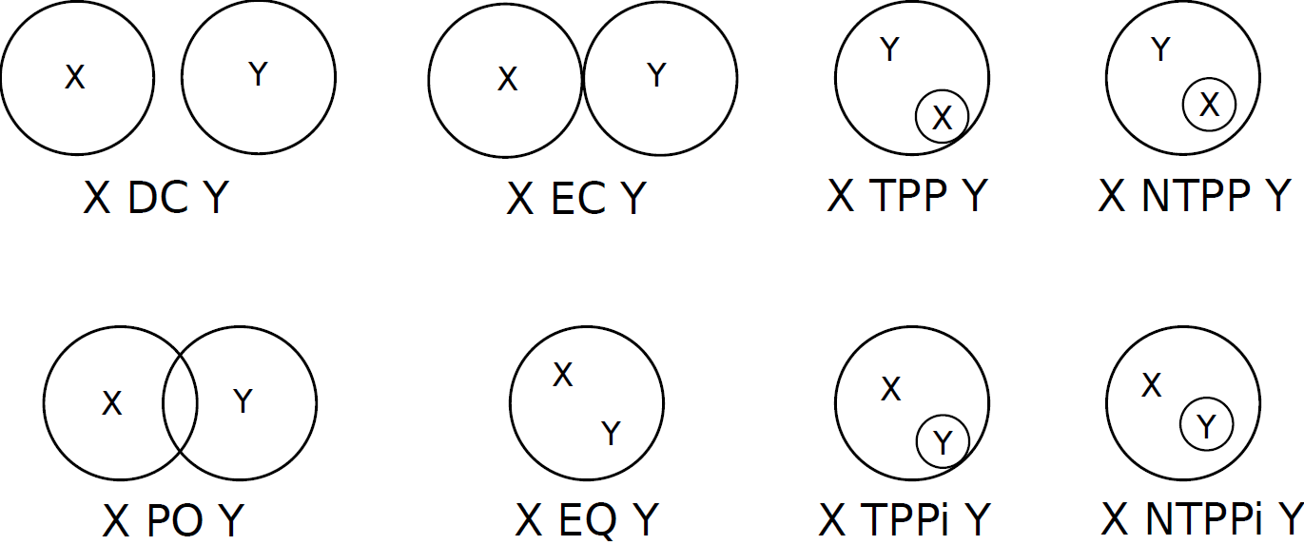
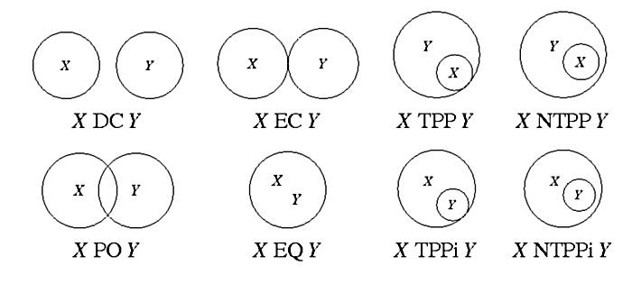
The RCC-8 Calculus (Randell et al., 1991)
Eight JEPD binary relations that can be all defined in terms of a single primitive (connection of two regions).
13
Notes:
Suvayu Ali, S.F.U.
13
5/17/11
Suvayu Ali, S.F.U.
13

Slide 14
RCC-8 (cont’d)
Variations exist depending on:
  What kind of regions of a topological space are considered (non-empty, regular, closed, connected, holes allowed, dimensionality).
  How is contact of two regions defined (the regions have a point in common or their closures have a point in common).
The RCC-5 subset has also been studied (no distinction among TPP and NTPP, called just PP).
14
Notes:
Suvayu Ali, S.F.U.
14
5/17/11
Suvayu Ali, S.F.U.
14

Slide 15
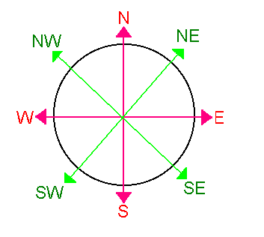

More Qualitative Spatial Relations
Orientation/Cardinal directions (left of, right of, north of, south of, northeast of etc.)
Distance (close to, far from etc.). This information can also be quantitative.
15
Notes:
Suvayu Ali, S.F.U.
15
5/17/11
Suvayu Ali, S.F.U.
15

Slide 16
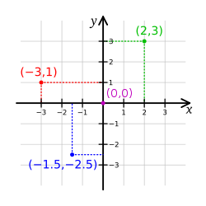
Coordinate Systems
Coordinate: one of n scalar values that determines the position of a point in an n-dimensional space.
Coordinate system: a set of mathematical rules for specifying how coordinates are to be assigned to points.
Example: the Cartesian coordinate system
16
Notes:
Suvayu Ali, S.F.U.
16
5/17/11
Suvayu Ali, S.F.U.
16

Slide 17
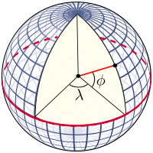
Coordinate Reference Systems
Coordinate reference system: a coordinate system that is related to an object (e.g., the Earth, a planar projection of the Earth, a three dimensional mathematical space such as R³) through a datum which species its origin, scale, and orientation.
Geographic coordinate reference system: a 3-dimensional coordinate system that utilizes latitude (φ), longitude (λ) , and optionally geodetic height (i.e., elevation), to capture geographic locations on Earth.
17
Notes:
Suvayu Ali, S.F.U.
17
5/17/11
Suvayu Ali, S.F.U.
17

Slide 18
The World Geodetic System
The World Geodetic System (WGS) is the most well-known geographic coordinate reference system and its latest revision is WGS84.
Applications: cartography, geodesy, navigation (GPS), etc.
18
Notes:
Suvayu Ali, S.F.U.
18
5/17/11
Suvayu Ali, S.F.U.
18

Slide 19
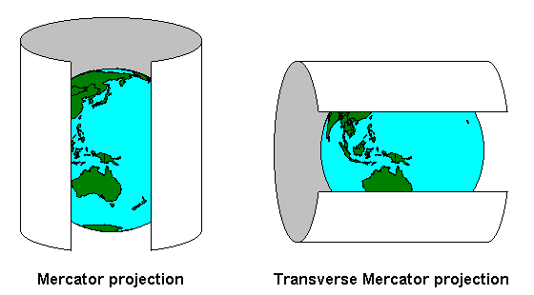
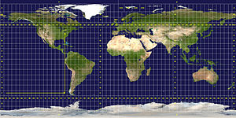
Projected Coordinate Reference Systems
Projected coordinate reference system: they transform the 3-dimensional ellipsoid approximation of the Earth into a 2-dimensional surface (distortions!)
Example: the Universal Transverse Mercator (UTM) system
19
Notes:
Suvayu Ali, S.F.U.
19
5/17/11
Suvayu Ali, S.F.U.
19

Slide 20
Coordinate Reference Systems (cont’d)
There are well-known ways to translate between co-ordinate reference systems.
Various authorities maintain lists of coordinate reference systems. See for example:
  OGC http://www.opengis.net/def/crs/
  European Petroleum Survey Group http://www.epsg-registry.org/
20
Notes:
Suvayu Ali, S.F.U.
20
5/17/11
Suvayu Ali, S.F.U.
20

Slide 21
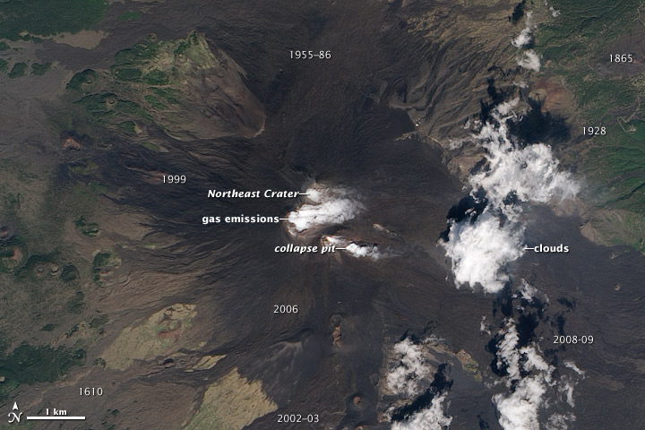
Abstract Modeling Paradigms: Feature-based
Feature-based (or entity-based or object-based). This kind of modeling is based on the concepts we presented already.
21
Notes:
Suvayu Ali, S.F.U.
21
5/17/11
Suvayu Ali, S.F.U.
21

Slide 22
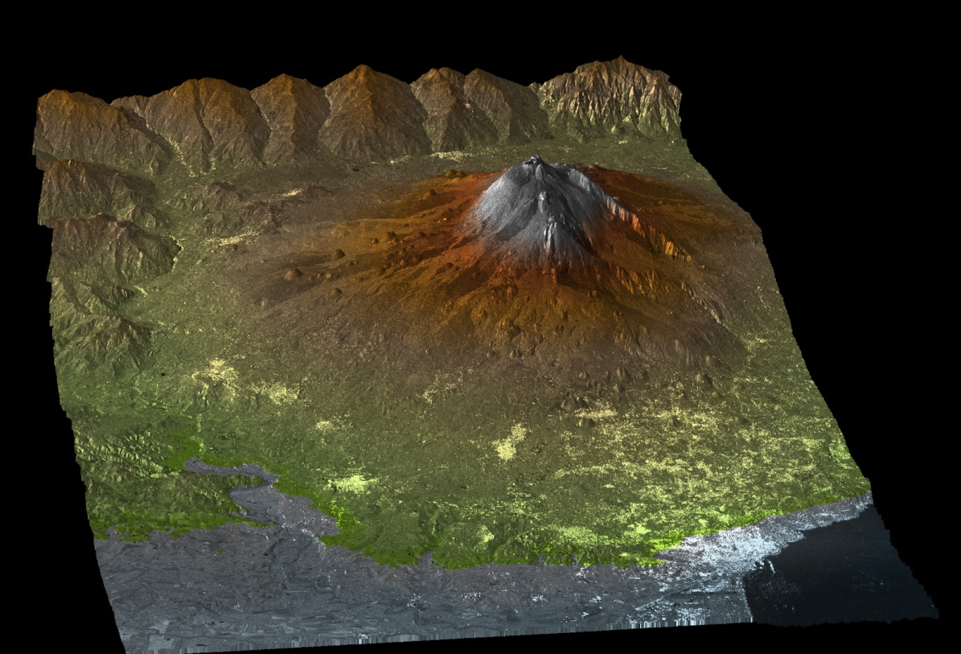
Abstract Modeling Paradigms: Field-based
Each point (x,y) in geographic space is associated with one or several attribute values defined as continuous functions in x and y.
Examples: elevation, precipitation, humidity, temperature for each point (x,y) in the Euclidean plane.
22
Notes:
Suvayu Ali, S.F.U.
22
5/17/11
Suvayu Ali, S.F.U.
22

Slide 23
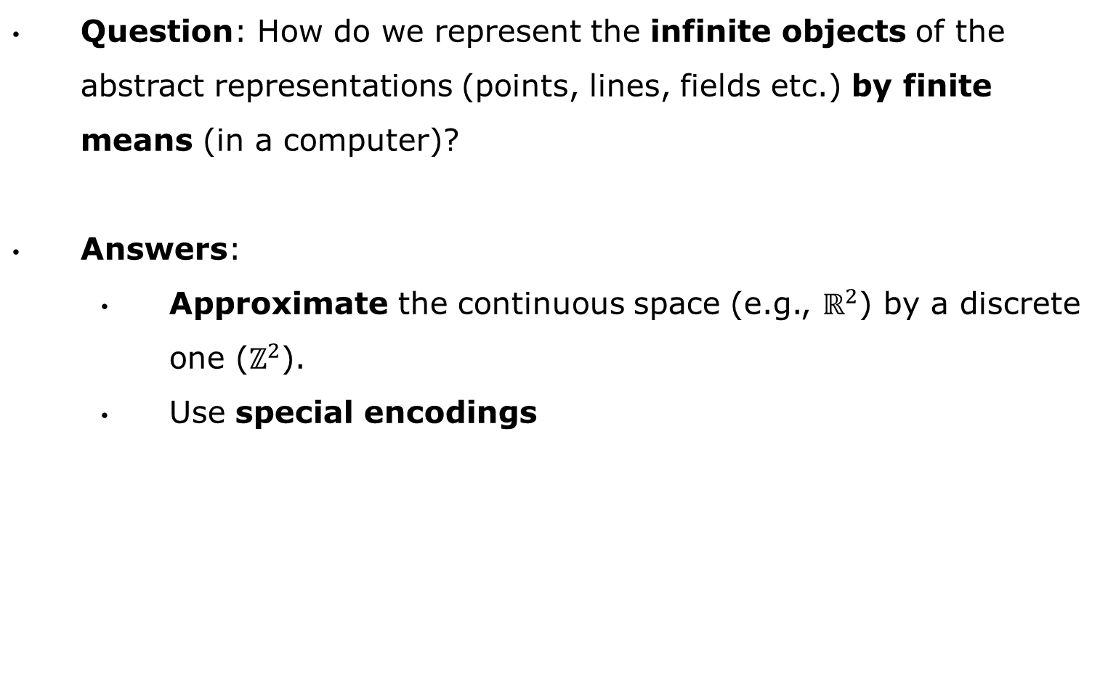
From Abstract Modeling to Concrete Representations
Question: How do we represent the infinite objects of the abstract representations (points, lines, fields etc.) by finite means (in a computer)?
Answers:
  Approximate the continuous space (e.g., $ℝ^{2}$) by a discrete one ($ℤ^{2}$).
  Use special encodings
23
Notes:
Suvayu Ali, S.F.U.
23
5/17/11
Suvayu Ali, S.F.U.
23

Slide 24
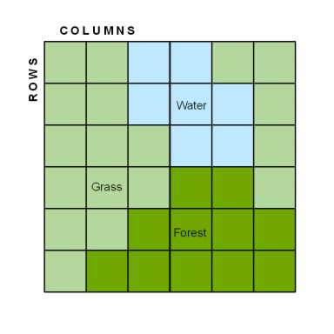
Concrete Representations - Tessellation
In this case a cellular decomposition of the plane (usually, a grid) serves as a basis for representing the geometry.
Example: raster representation
24
Notes:
Suvayu Ali, S.F.U.
24
5/17/11
Suvayu Ali, S.F.U.
24

Slide 25
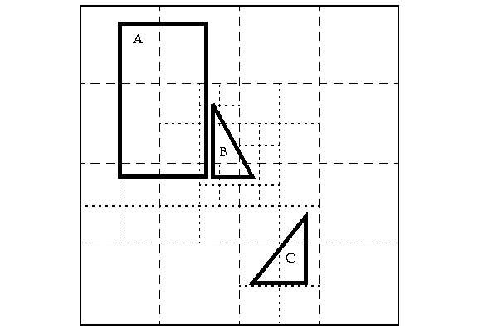
Tessellation (cont’d)
Tiling (variable sized)
25
Notes:
Suvayu Ali, S.F.U.
25
5/17/11
Suvayu Ali, S.F.U.
25

Slide 26
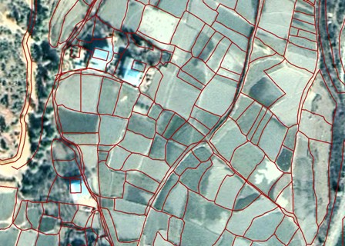
Tessellation (cont’d)
Cadastral map (irregular tessellation) overlayed on a satellite image.
26
Notes:
Suvayu Ali, S.F.U.
26
5/17/11
Suvayu Ali, S.F.U.
26

Slide 27
Concrete Representations: Vectors
In this case objects are constructed from points and line segments as primitives as follows:
  A point is represented by a tuple of coordinates.
  A line segment is represented by a pair with its beginning and ending point.
  More complex objects such as arbitrary lines, curves, surfaces etc. are built recursively by the basic primitives using constructs such as lists, sets etc.
27
Notes:
Suvayu Ali, S.F.U.
27
5/17/11
Suvayu Ali, S.F.U.
27

Slide 28
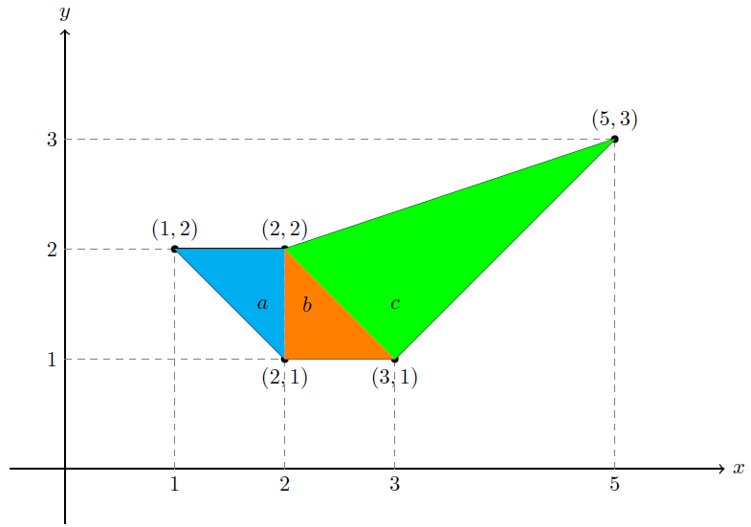
Concrete Representations: Vectors
[(1,2) (2,2) (5,3) (3,1) (2,1) (1 2)]
28
Notes:
Suvayu Ali, S.F.U.
28
5/17/11
Suvayu Ali, S.F.U.
28

Slide 29
Concrete Representations: Constraints
In this case objects are represented by quantifier free formulas in a constraint language (e.g., linear constraints).
29
Notes:
Suvayu Ali, S.F.U.
29
5/17/11
Suvayu Ali, S.F.U.
29

Slide 30


Geospatial Data Standards
The Open Geospatial Consortium (OGC) and the International Organization for Standardization (ISO) have developed many geospatial data standards that are in wide use today. In this tutorial we will cover:
  Well-Known Text
  Geography Markup Language
  OpenGIS Simple Feature Access
30
Notes:
Suvayu Ali, S.F.U.
30
5/17/11
Suvayu Ali, S.F.U.
30

Slide 31
Well-Known Text (WKT)
WKT is an OGC and ISO standard for representing geometries, coordinate reference systems, and transformations between coordinate reference systems.
WKT is specified in OpenGIS Simple Feature Access - Part 1: Common Architecture standard which is the same as the ISO 19125-1 standard. Download from http://portal.opengeospatial.org/files/?artifact_id=25355 .
This standard concentrates on simple features: features with all spatial attributes described piecewise by a straight line or a planar interpolation between sets of points.
31
Notes:
Suvayu Ali, S.F.U.
31
5/17/11
Suvayu Ali, S.F.U.
31

Slide 32
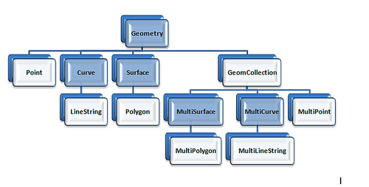
WKT Class Hierarchy
32
Notes:
Suvayu Ali, S.F.U.
32
5/17/11
Suvayu Ali, S.F.U.
32

Slide 33
Example
WKT representation:
  GeometryCollection(
  Point(5 35),
  LineString(3 10,5 25,15 35,20 37,30 40),
  Polygon((5 5,28 7,44 14,47 35,40 40,20 30,5 5),
  (28 29,14.5 11,26.5 12,37.5 20,28 29))
  )
33
Notes:
Suvayu Ali, S.F.U.
33
5/17/11
Suvayu Ali, S.F.U.
33

Slide 34
Geography Markup Language (GML)
GML is an XML-based encoding standard for the representation of geospatial data.
GML provides XML schemas for defining a variety of concepts: geographic features, geometry, coordinate reference systems, topology, time and units of measurement.
GML profiles are subsets of GML that target particular applications.
  Examples: Point Profile, GML Simple Features Profile etc.
34
Notes:
Suvayu Ali, S.F.U.
34
5/17/11
Suvayu Ali, S.F.U.
34

Slide 35
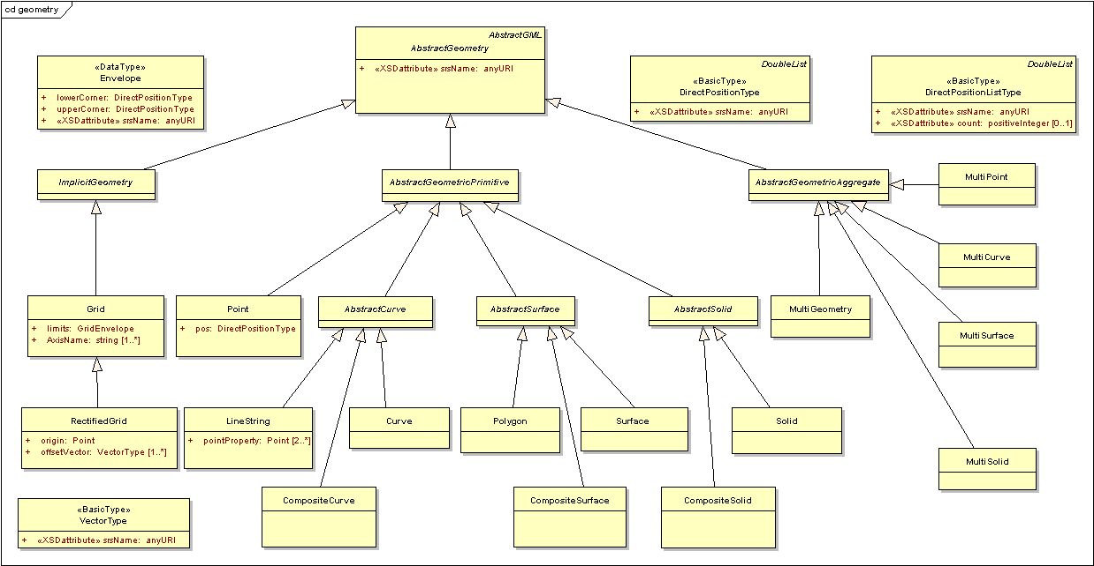
GML Simple Features: Class Hierarchy
35
Notes:
Suvayu Ali, S.F.U.
35
5/17/11
Suvayu Ali, S.F.U.
35
Υπάρχουν μικροδιαφορές στα 2-d objects, αλλα η βασική διαφορά είναι ότι η GML υποστηρίζει 3-d objects.
Θέλετε να ξαναφτιάξουμε το σχήμα;

Slide 36
Example
GML representation:
<gml:Polygon gml:id="p3" srsName="urn:ogc:def:crs:EPSG:6.6:4326”>
<gml:exterior>
<gml:LinearRing>
<gml:coordinates>
5,5 28,7 44,14 47,35 40,40 20,30 5,5
</gml:coordinates>
</gml:LinearRing>
</gml:exterior>
</gml:Polygon>
36
Notes:
Suvayu Ali, S.F.U.
36
5/17/11
Suvayu Ali, S.F.U.
36

Slide 37
OpenGIS Simple Features Access (cont’d)
OGC has also specified a standard for the storage, retrieval, query and update of sets of simple features using relational DBMS and SQL.
This standard is “OpenGIS Simple Feature Access - Part 2: SQL Option” and it is the same as the ISO 19125-2 standard. Download from http://portal.opengeospatial.org/files/?artifact_id=25354.
Related standard: ISO 13249 SQL/MM - Part 3.
37
Notes:
Suvayu Ali, S.F.U.
37
5/17/11
Suvayu Ali, S.F.U.
37

Slide 38
OpenGIS Simple Features Access (cont’d)
The standard covers two implementations options: (i) using only the SQL predefined data types and (ii) using SQL with geometry types.
SQL with geometry types:
  We use the WKT geometry class hierarchy presented earlier to define new geometric data types for SQL
  We define new SQL functions on those types.
38
Notes:
Suvayu Ali, S.F.U.
38
5/17/11
Suvayu Ali, S.F.U.
38

Slide 39
SQL with Geometry Types - Functions
Functions that request or check properties of a geometry:
  ST Dimension(A:Geometry, B:Geometry):Integer
  ST_GeometryType(A:Geometry):Character Varying
  ST_AsText(A:Geometry): Character Large Object
  ST_AsBinary(A:Geometry): Binary Large Object
  ST_SRID(A:Geometry): Integer
  ST_IsEmpty(A:Geometry): Boolean
  ST_IsSimple(A:Geometry): Boolean
39
Notes:
Suvayu Ali, S.F.U.
39
5/17/11
Suvayu Ali, S.F.U.
39

Slide 40
SQL with Geometry Types – Functions (cont’d)
Functions that test topological spatial relationships between two geometries using the DE-9IM:
  ST_Equals(A:Geometry, B:Geometry):Boolean
  ST_Disjoint(A:Geometry, B:Geometry):Boolean
  ST_Intersects(A:Geometry, B:Geometry):Boolean
  ST_Touches(A:Geometry, B:Geometry):Boolean
  ST_Crosses(A:Geometry, B:Geometry):Boolean
  ST_Within(A:Geometry, B:Geometry):Boolean
  ST_Contains(A:Geometry, B:Geometry):Boolean
  ST_Overlaps(A:Geometry, B:Geometry):Boolean
  ST_Relate(A:Geometry, B:Geometry, Matrix: Char(9)):Boolean
40
Notes:
Suvayu Ali, S.F.U.
40
5/17/11
Suvayu Ali, S.F.U.
40

Slide 41
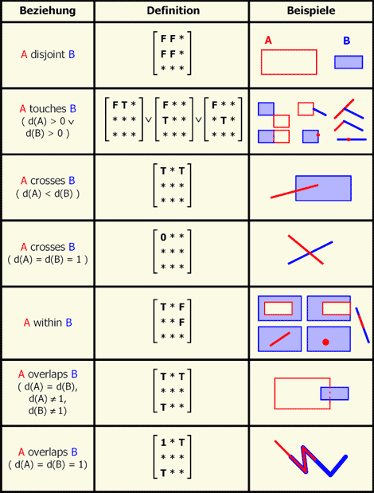
DE-9IM Relation Definitions
41
Notes:
Suvayu Ali, S.F.U.
41
5/17/11
Suvayu Ali, S.F.U.
41

Slide 42
SQL with Geometry Types – Functions (cont’d)
Functions for constructing new geometries out of existing ones:
  ST Boundary(A:Geometry):Geometry
  ST_Envelope(A:Geometry):Geometry
  ST_Intersection(A:Geometry, B:Geometry):Geometry
  ST_Union(A:Geometry, B:Geometry):Geometry
  ST_Difference(A:Geometry, B:Geometry):Geometry
  ST_SymDifference(A:Geometry, B:Geometry):Geometry
  ST_Buffer(A:Geometry, distance:Double):Geometry
42
Notes:
Suvayu Ali, S.F.U.
42
5/17/11
Suvayu Ali, S.F.U.
42

Slide 43


Geospatial Relational DBMS
The OpenGIS Simple Features Access Standard is today been used in all relational DBMS with a geospatial extension.
  The abstract data type mechanism of the DBMS allows the representation of all kinds of geospatial data types supported by the standard.
  The query language (SQL) offers the functions of the standard for querying data of these types.
43
Notes:
Suvayu Ali, S.F.U.
43
5/17/11
Suvayu Ali, S.F.U.
43

Slide 44
Conclusions
Background in geospatial data modeling:
  Why geographical information?
  Geographical Information Science and Systems
  Geospatial data on the Web and linked geospatial data
  Abstract geographic space modeling paradigms: discrete objects vs. continuous fields
  Concrete representations: tessellation vs. vectors vs. constraints
  Geospatial data standards
Next topic: Geospatial data in the Semantic Web
44
Notes:
Suvayu Ali, S.F.U.
44
5/17/11
Suvayu Ali, S.F.U.
44

